Slide 1


Predictive Analysis of Ad-click Website data
Submitted by- Rahul Sisodia

Slide 2

Aim of the project
The goal of the case study is to Predict who is likely going to click on the Advertisement so it can contribute to the more revenue generation to the organization
Considering this objective, we are running a **Logistic regression model** on target/dependent variable to analyze the influence of several independent factors that affect our target variables .

Slide 3
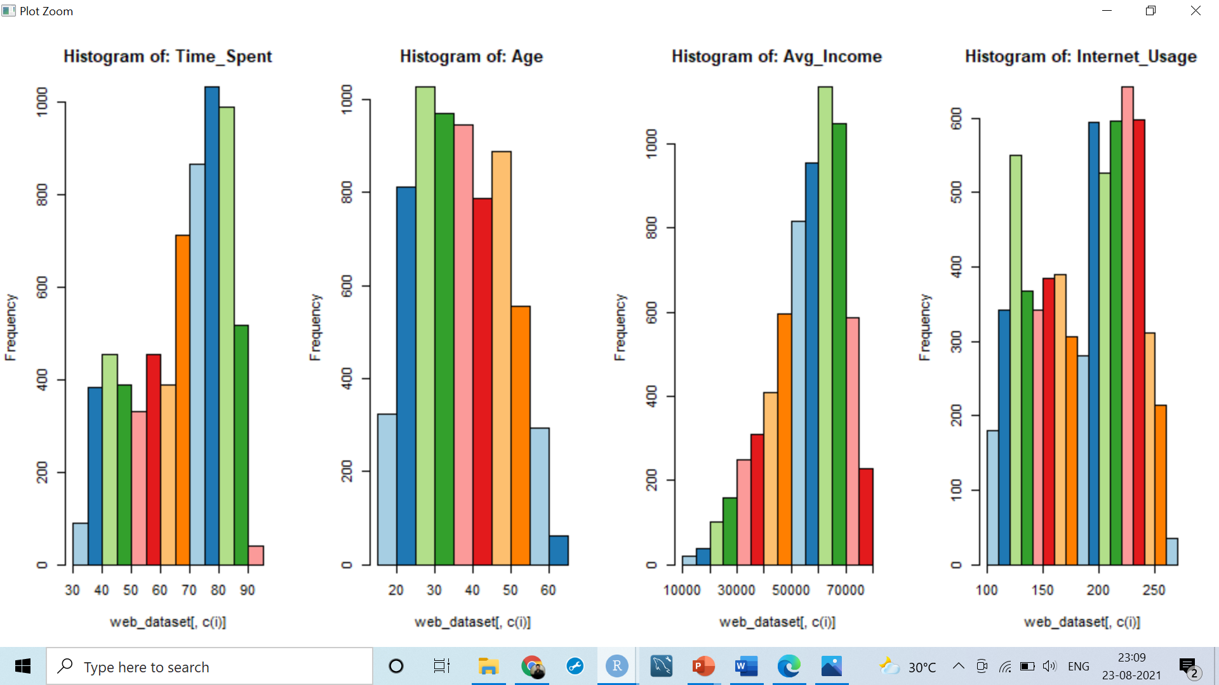
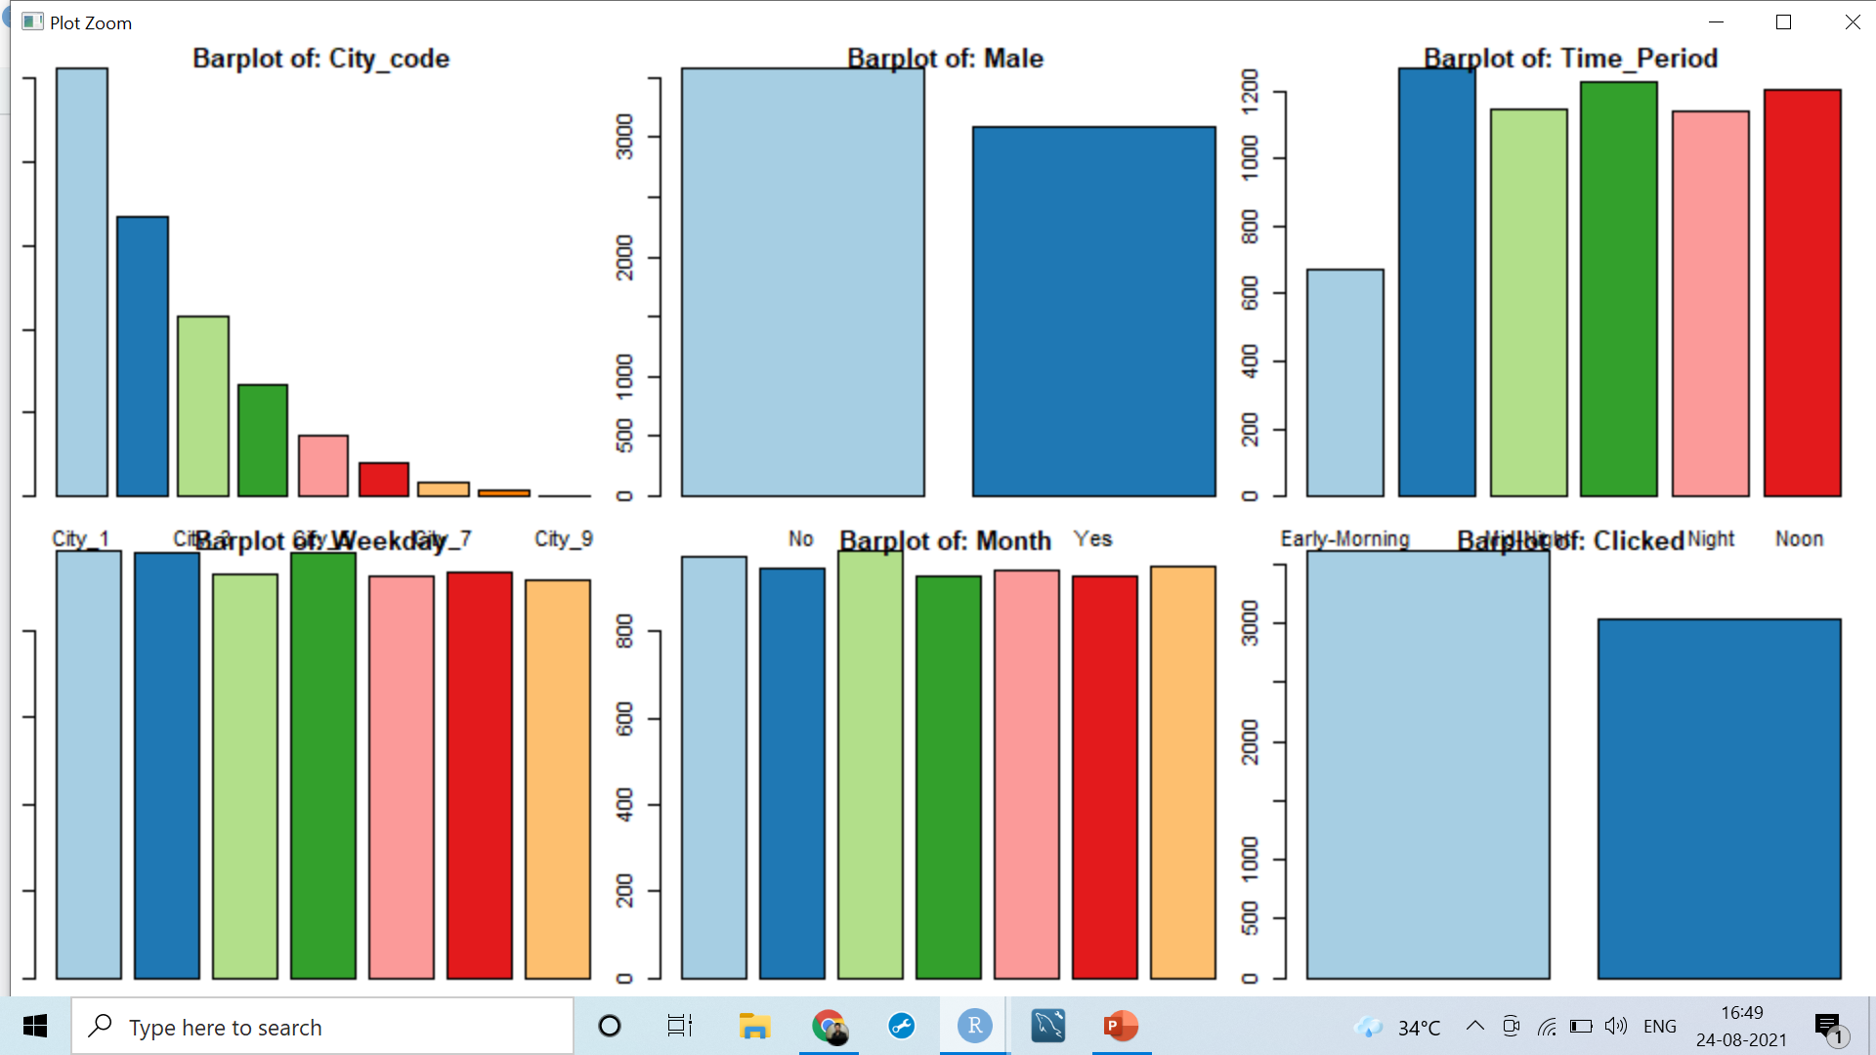
Univariate analysis:
Graphical representations makes your variable description easier to explain
Continuous variables – Histogram
Categorical variables – Bar plot

Slide 4
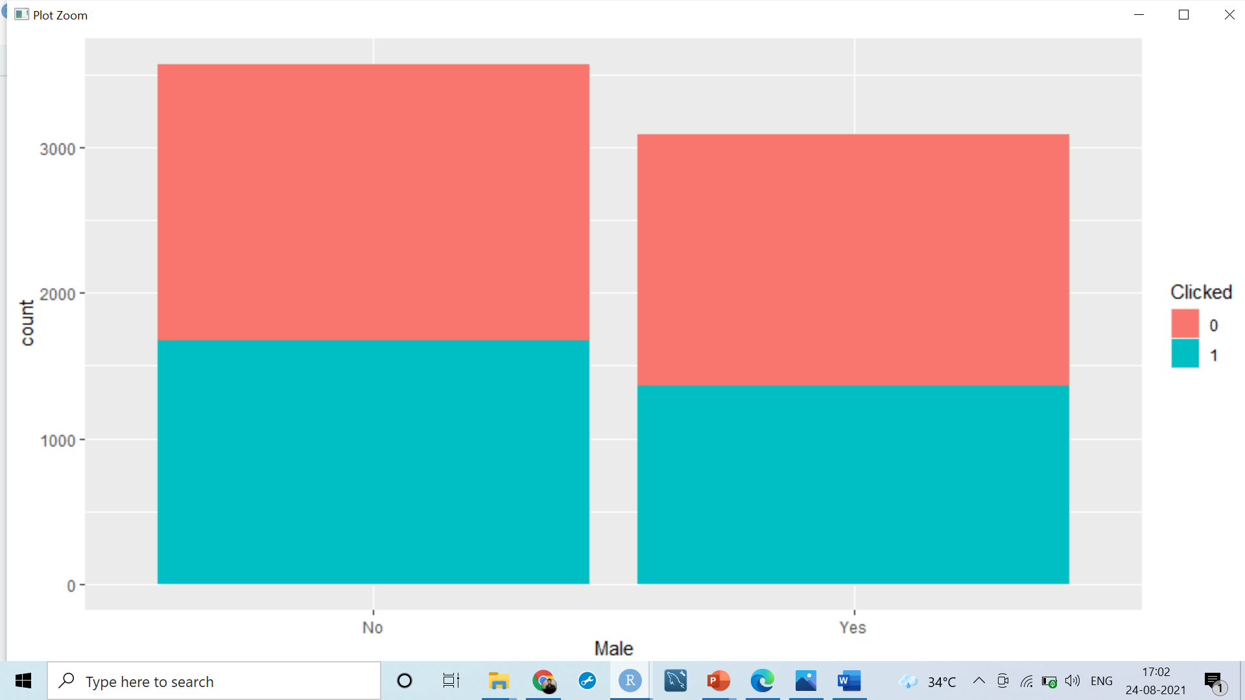
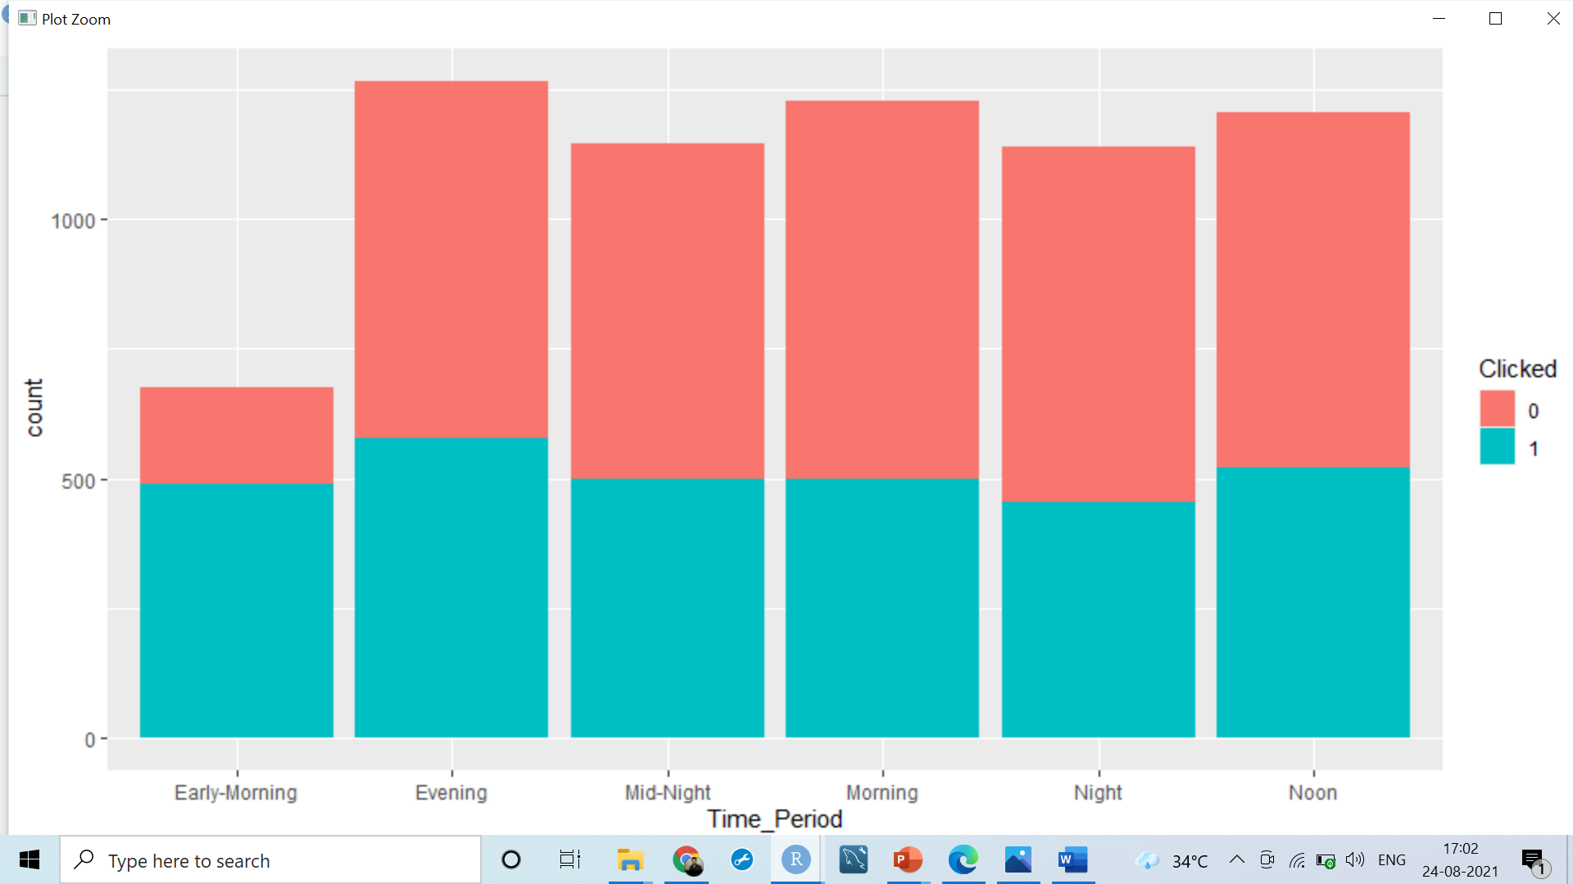
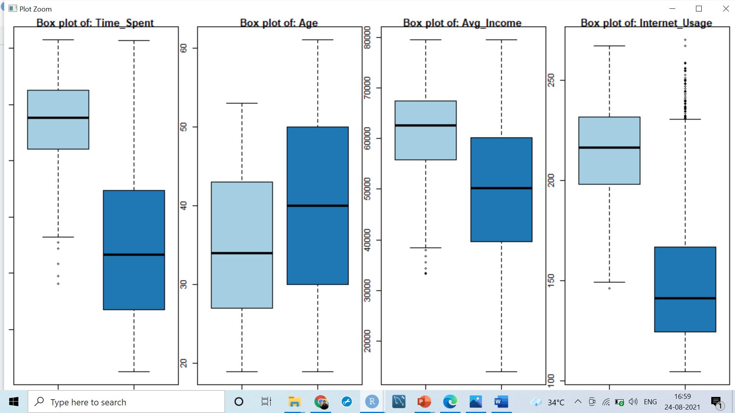
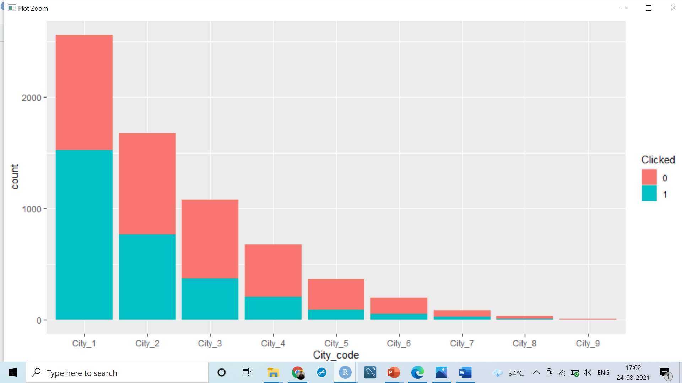
Bivariate analysis
In the evening clicked are bit more as compared to other time.
In the city 1 has max no of clicked as compared to another city.
Female has more clicked on Ad as compared to male Finally, if we are wondering whether the site is visited more by men or women, we can see that the situation is almost equal (52% in favour of women).

Slide 5
Statistical Relationship
Continuous Vs Categorical relationship strength: Analysis of Variance (ANOVA)
H0: Variables are NOT correlated
Small P-Value <5%--> Variables are correlated (H0 is rejected)
Large P-Value--> Variables are NOT correlated (H0 is accepted)
All variables are good for prediction because p-value less than 0.05
Categorical variables Vs Categorical variables -- Chi-square test
Column weekdays: p-value = 0.7226 and Column Month: p-value = 0.4229, We will not be considering these two variables in further analysis because the p- value is greater than 0.05

Slide 6
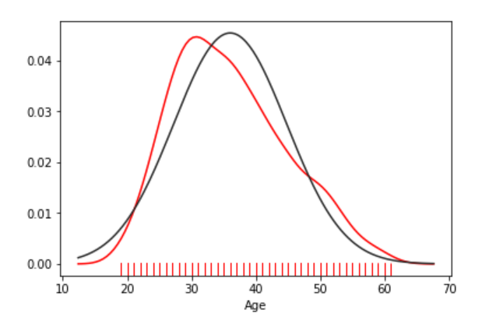
Significant variables:
Time_Spent
Age
Avg_Income
Internet_Usage
City_code
Time_Period
It can be concluded that the variable 'Age' has a normal distribution of data

Slide 7
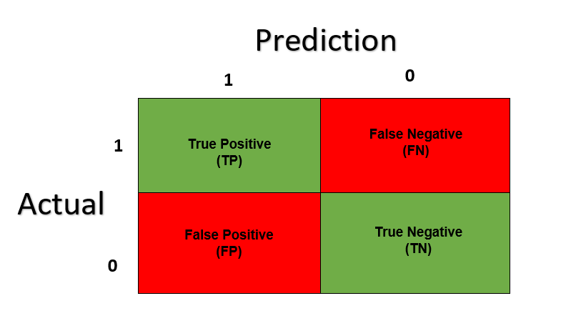
Predictions of the model
Using the obtained model, generate the prediction probabilities on the test data. Considering the threshold, obtain the predictions on the test data set.
considering the thresholds value 0.50
our model is 91% accuracy based on 95% of confidence interval accuracy lies between (0.8991, 0.9244)
Sensitivity/Recall: 0.9000
Specificity: 0.9229
Pos Pred Value/precision: 0.9089
we will calculate F1-score= 2*(recall* precision)/recall + precision
f1<- 2*(0.9000* 0.9089)/ (0.9000+0.9089)
f1 =0.9044281

Slide 8

Business Recommendation
It can be concluded that the variable 'Age' has a normal distribution of data. we can conclude that younger users spend more time on the site. This implies that users of the age between 20 and 40 years can be the main target group for the marketing campaign.
Hypothetically, if we have a product intended for middle-aged people, this is the right site for advertising.
Conversely, if we have a product intended for people over the age of 60, it would be a mistake to advertise on this site.

Slide 9

Thank You

